Slide 1
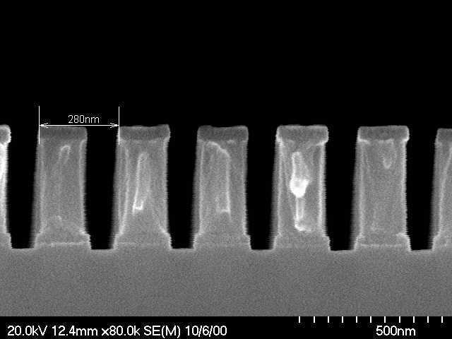
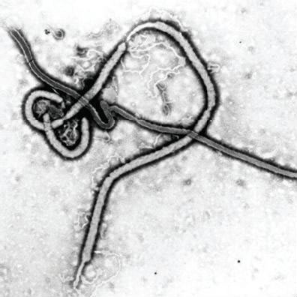
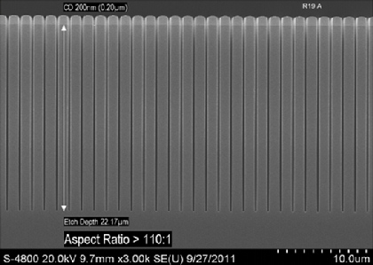
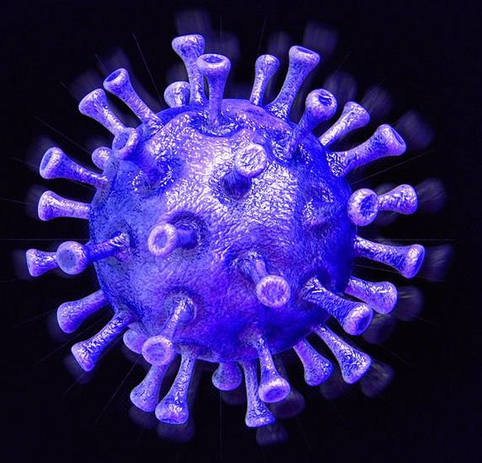
Plasma Science: the unsung engine of the digital age
Steven Shannon
22 June 2022
Peter Clarke, “Applied Materials readies DRIE machines
for MEMS, EETimes Magazine, 22 March 2012

Slide 2
How do we control the direction of a chemically driven process?
How do we make things so small?
Current SOA is 5nm!!!
Peter Clarke, “Applied Materials readies DRIE machines
for MEMS, EETimes Magazine, 22 March 2012

Slide 3
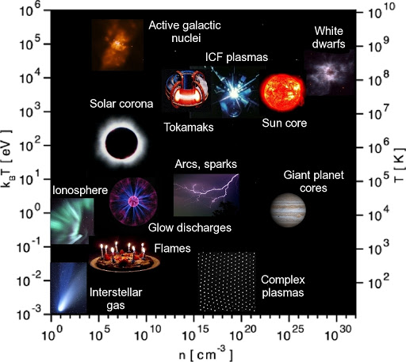

Slide 4
The majority of plasma processing resides in a pretty small window in “plasma space”
10⁸cm⁻³ < n_{e} < 10¹²cm⁻³
0.5eV < T_{e} <10eV
Less than 1% of the gas is actually ionized
The background gas (and ions) stay roughly near room temperature

Slide 5
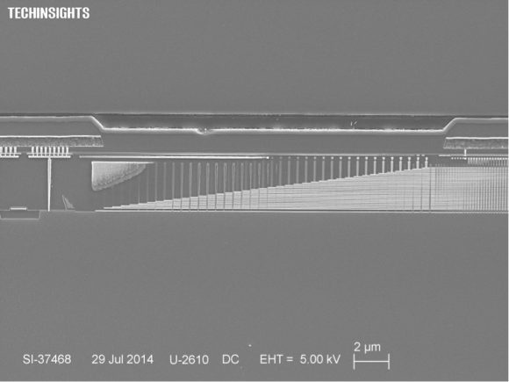
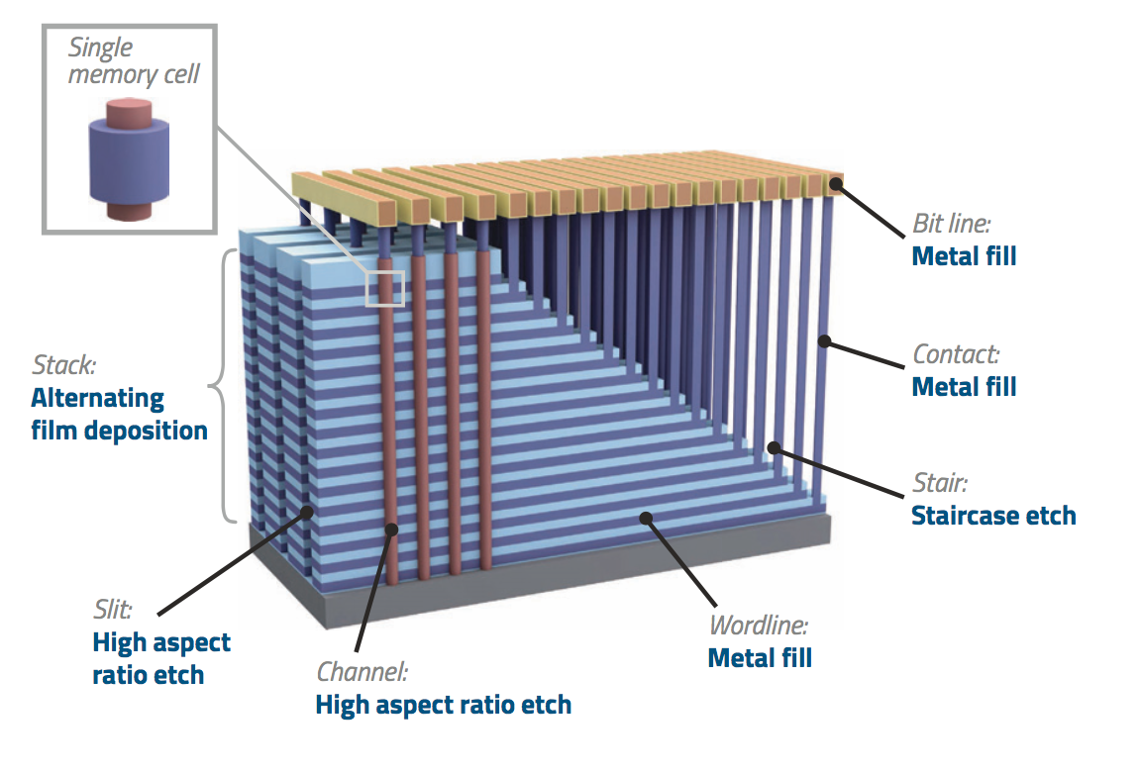
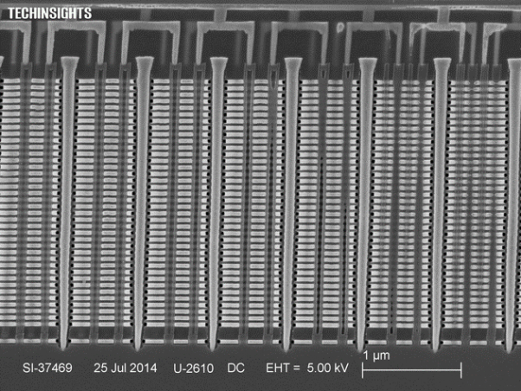
The basic challenge – fabrication of very complex features with dimensions ~10nm
Harmeet Singh, “Overcoming challenges in 3D NAND volume manufacturing, Solid State Technology Magazine, July 2017
Dick James, “The Second Shoe Drops – Samsung V-NAND Flash”, www.chipworks.com, 5 August 2014

Slide 6
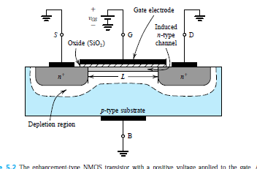
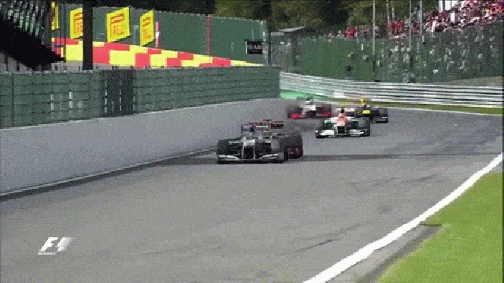
Why? Because the smaller the device, the faster it runs…

Slide 7
There are lots of challenges to make this device… we will focus on High Aspect Ratio etching in dielectric materials
Peter Clarke, “Applied Materials readies DRIE machines
for MEMS, EETimes Magazine, 22 March 2012

Slide 8
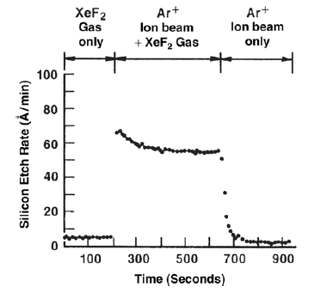
The “classic” experiment that drove plasma etch
XeF₂
Ar⁺
Silicon Wafer
Coburn and Winters, J. Vac. Sci. Technol. 16, 391

Slide 9
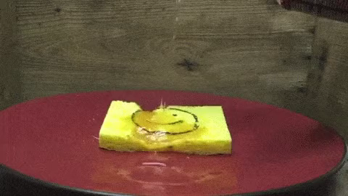
The “classic” experiment that drove plasma etch
XeF₂
Ar⁺
F
SiF₄
Silicon Wafer
Coburn and Winters, J. Vac. Sci. Technol. 16, 391

Slide 10
The “classic” experiment that drove plasma etch
XeF₂
Ar⁺
F
SiF₄
Silicon Wafer
Coburn and Winters, J. Vac. Sci. Technol. 16, 391

Slide 11
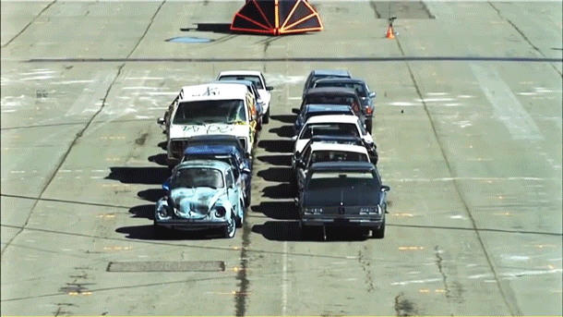
The “classic” experiment that drove plasma etch
XeF₂
Ar⁺
Ar⁺ @500V
Si
Silicon Wafer

Slide 12
The “classic” experiment that drove plasma etch
XeF₂
Ar⁺
Ar⁺ @500V
Si
Silicon Wafer
Coburn and Winters, J. Vac. Sci. Technol. 16, 391

Slide 13
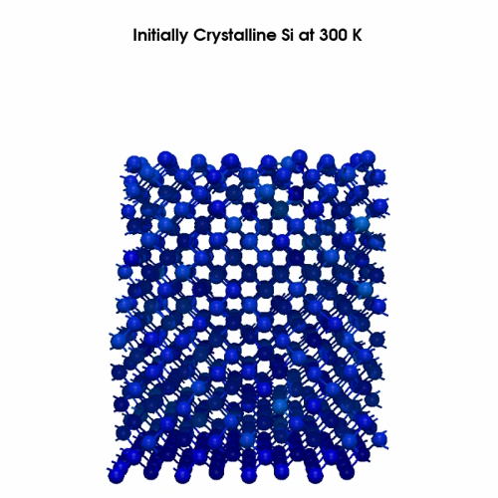
The “classic” experiment that drove plasma etch
XeF₂
Ar⁺
Ar⁺ @500V
Si
Silicon Wafer
MD simulation by Graves group, UC Berkeley

Slide 14
The “classic” experiment that drove plasma etch
XeF₂
Ar⁺
F
Ar⁺ @500V
SiF_{x}
Silicon Wafer
Coburn and Winters, J. Vac. Sci. Technol. 16, 391

Slide 15
The “classic” experiment that drove plasma etch
What we learned: ion bombardment and reactive chemistries work in synergy to accelerate chemical reactions on the surface and accelerate processes like etching
F
Chemically impervious mask
Vertical surfaces
Reactant only
Slow removal or
passivation
Ar⁺
Coburn and Winters, J. Vac. Sci. Technol. 16, 391
Horizontal surfaces:
Reactant + ions = fast removal

Slide 16
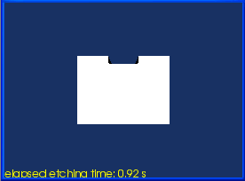
The “classic” experiment that drove plasma etch
What we learned: ion bombardment and reactive chemistries work in synergy to accelerate chemical reactions on the surface and accelerate processes like etching
F
Chemically impervious mask
Vertical surfaces
Reactant only
Slow removal or
passivation
Ar⁺
Horizontal surfaces:
Reactant + ions = fast removal

Slide 17
The “classic” experiment that drove plasma etch
What we learned: ion bombardment and reactive chemistries work in synergy to accelerate chemical reactions on the surface and accelerate processes like etching
F
Chemically impervious mask
Vertical surfaces
Reactant only
Slow removal or
passivation
Ar⁺
Horizontal surfaces:
Reactant + ions = fast removal

Slide 18
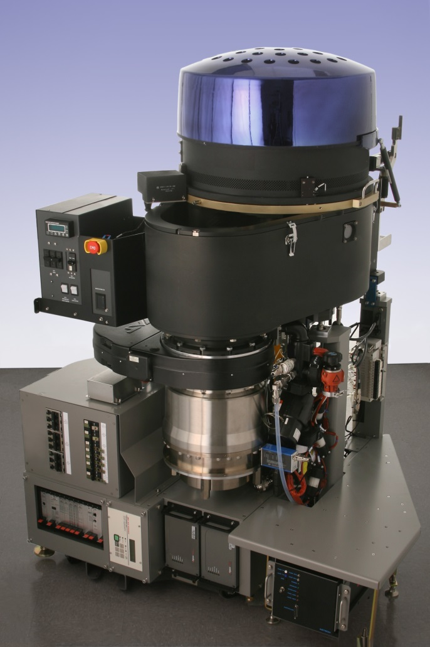
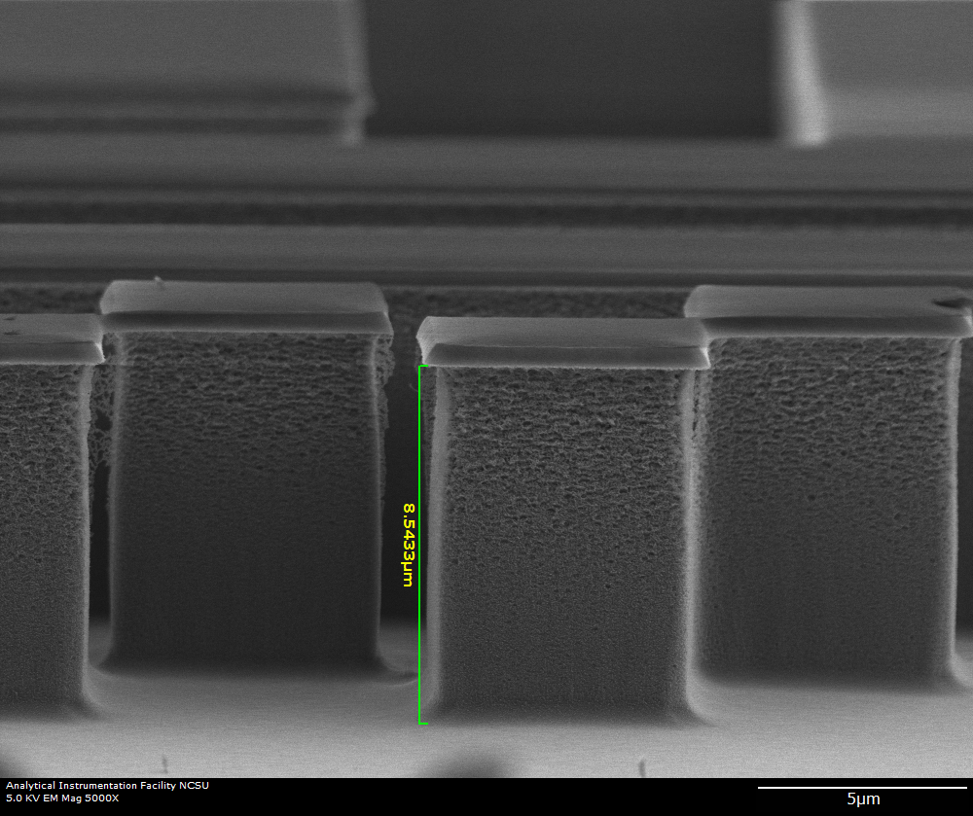
Fortunately this technology exists…
CF₄
Ion acceleration
Through RF sheath
Silicon Wafer
Applied Materials Advantage Etch System

Slide 19
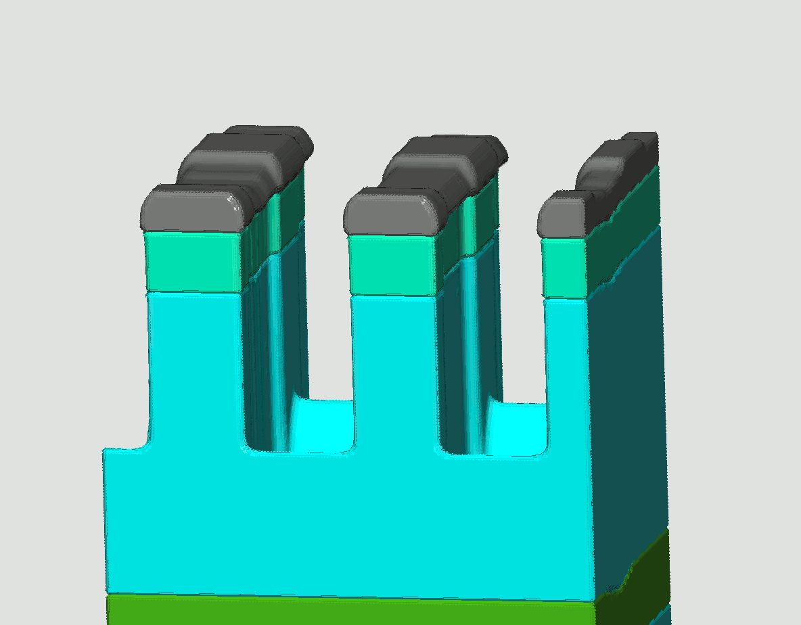
Fortunately this technology exists…
CF₄
Ion acceleration
Through RF sheath
Silicon Wafer
Applied Materials Advantage Etch System

Slide 20
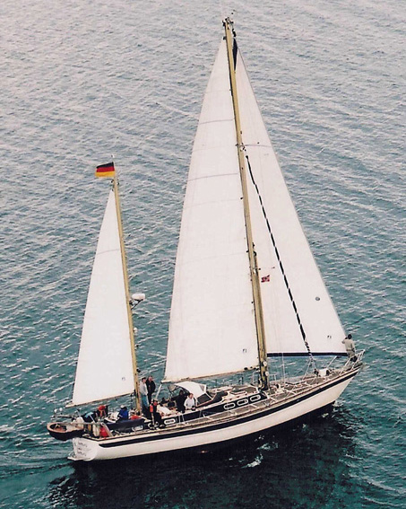
Fortunately this technology exists…
Costs more than a 53 foot yacht
(~ $1,000,000)
Has a vacuum chamber that can provide the same conditions as outer space
(base pressure < 1mTorr)
Turbo pump that spins faster than a jet engine (~25,000 RPM)
More RF power than a college radio station (~10,000 Watts)
Registered with the Federal Communications Commission
Applied Materials Advantage Etch System

Slide 21
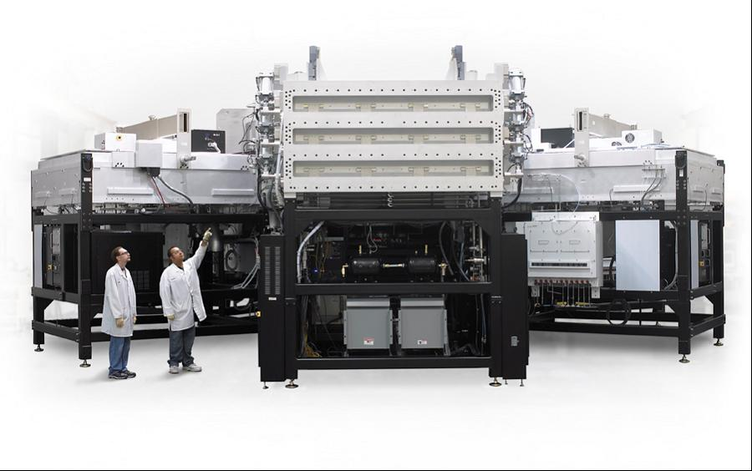
And it’s only getting bigger…

Slide 22
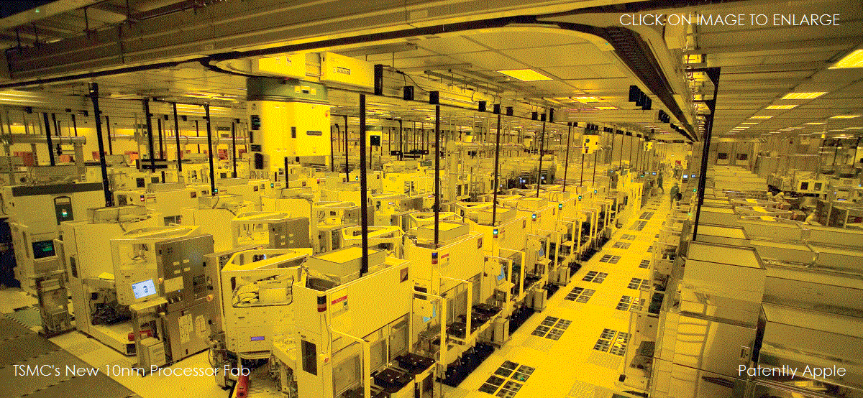
Fortunately this technology exists…

Slide 23
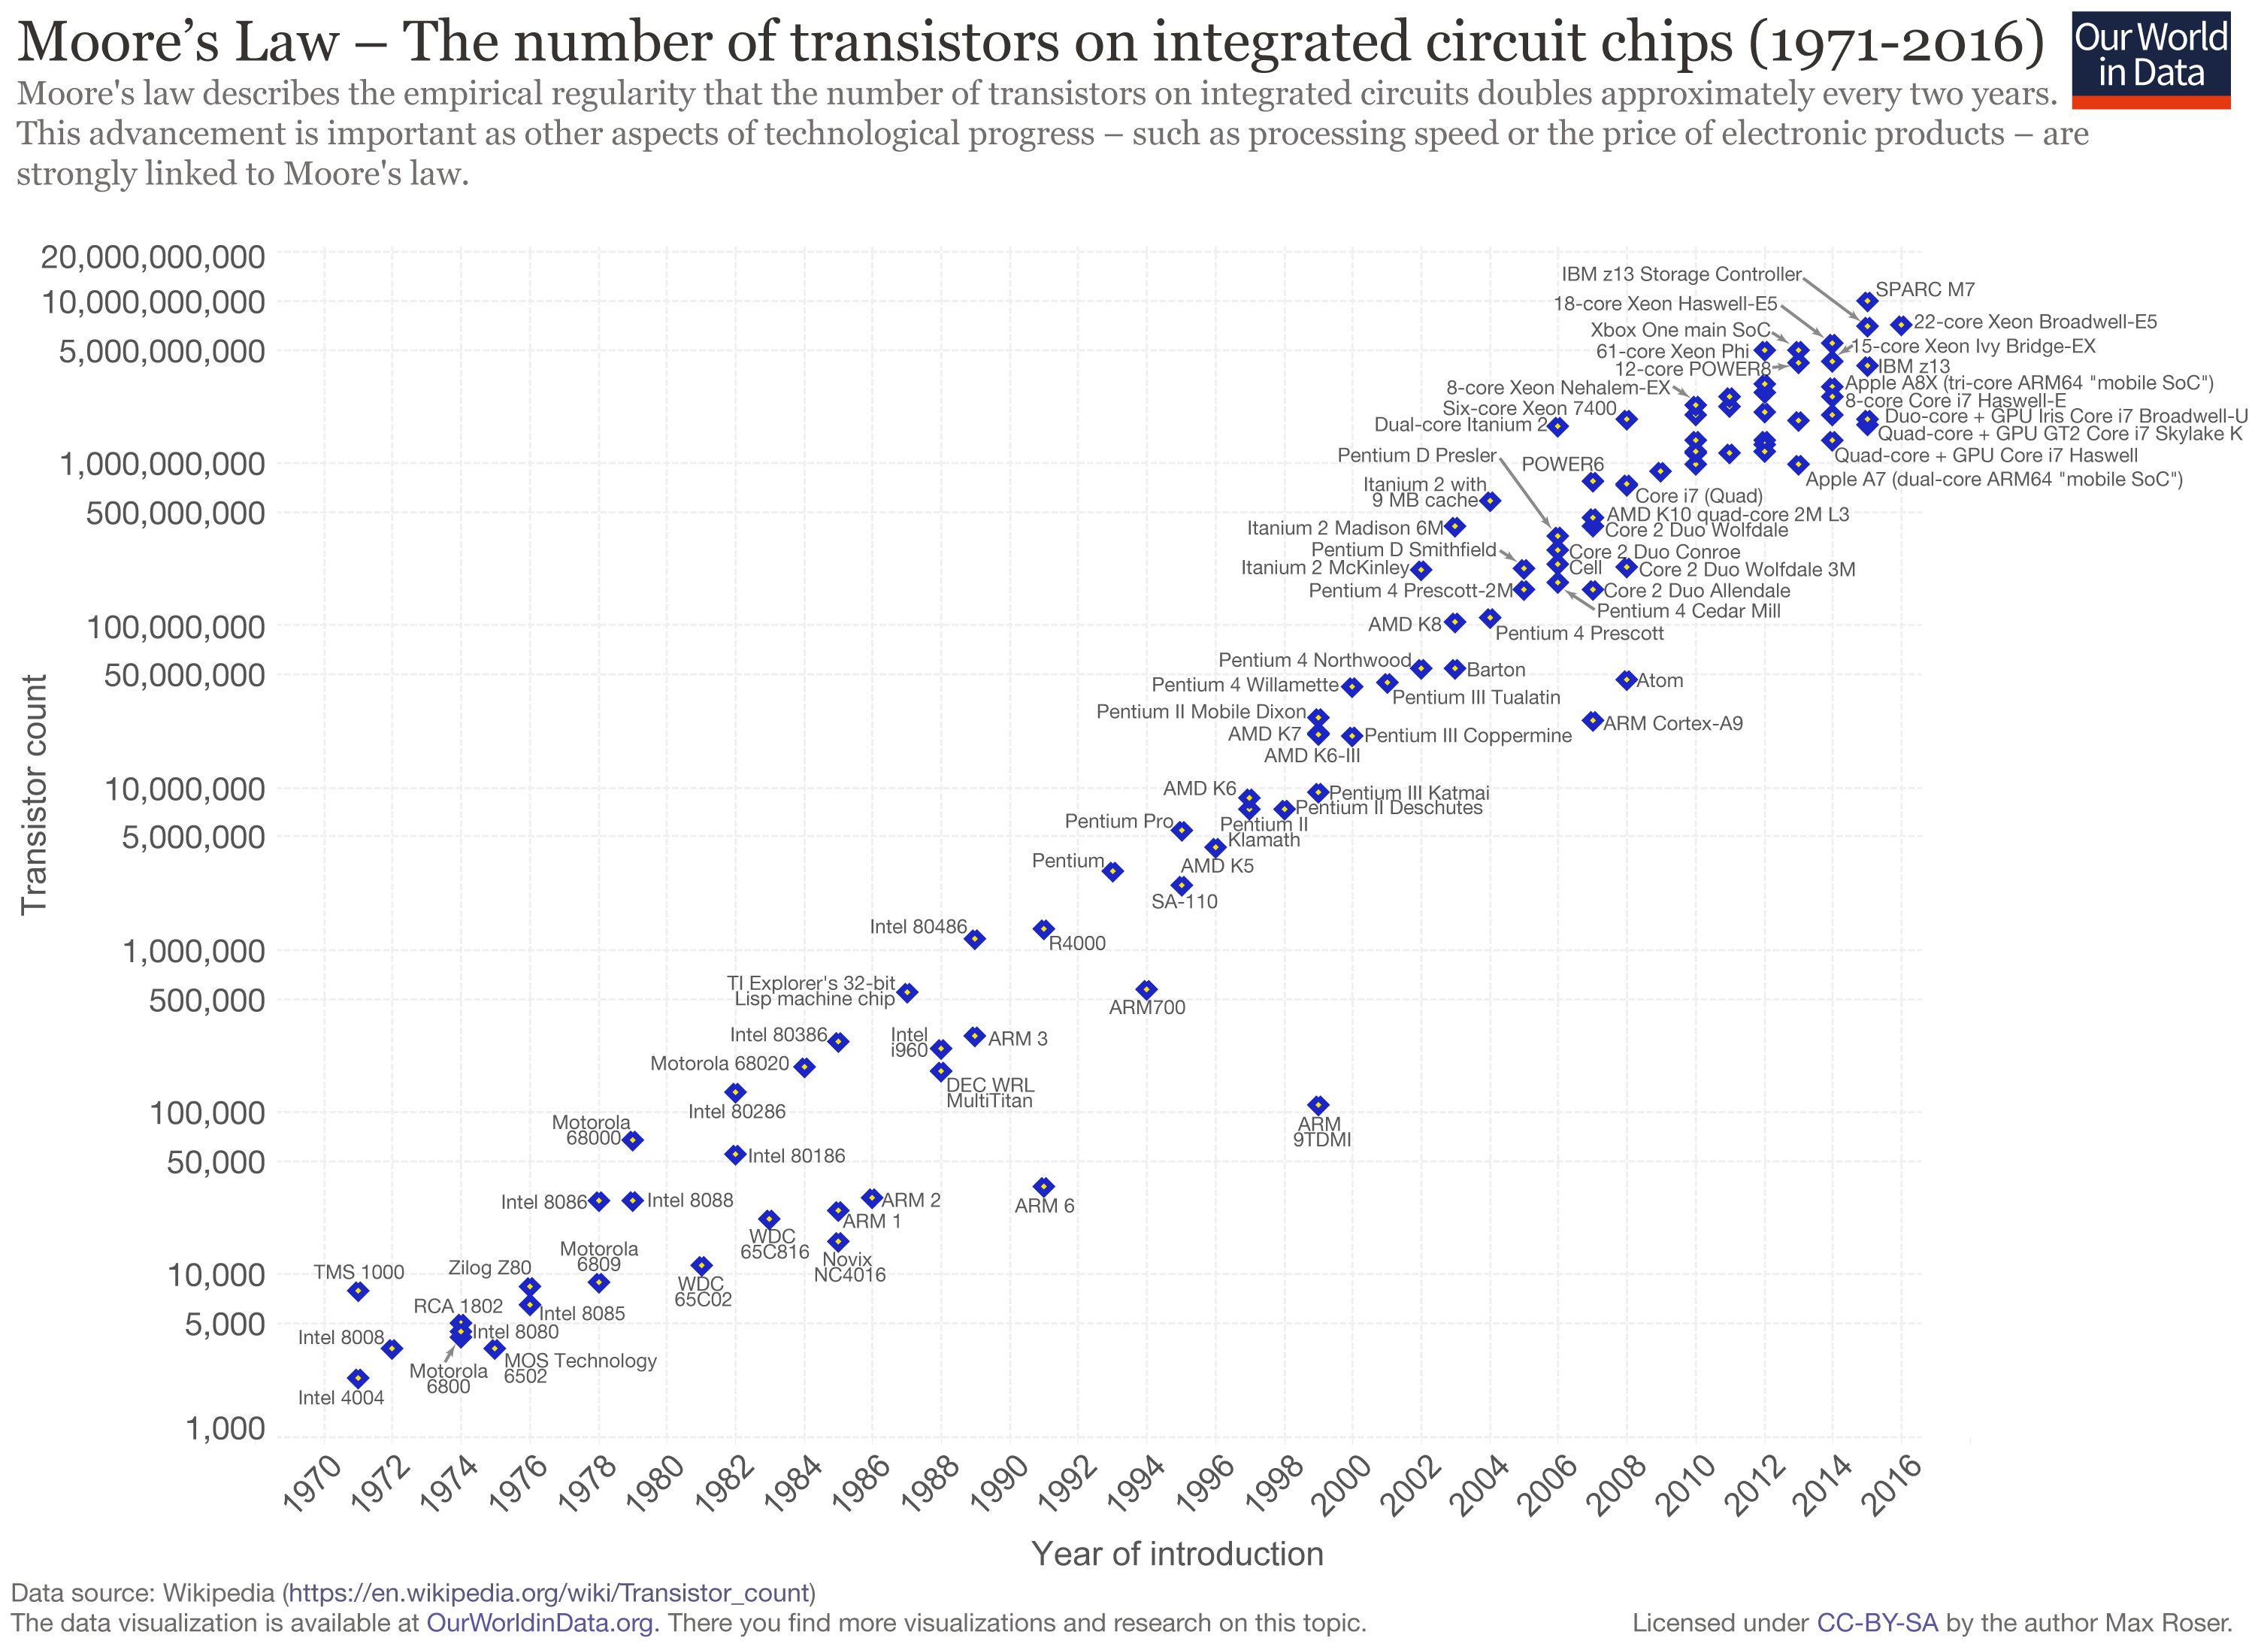
Seriously…. Fortunately this technology exists…
Pace of innovation is ridiculous… presents real R&D challenges, especially on the basic science side…
Without plasma processing we would be running on 1990’s era computing – 8MB memory, 500MB Hard Drive, no flat panels, 24 bit video, 28.8 kbs connectivity, 33MHz clock speed

Slide 24

So… how does it work? We need two things…
CF₄
Electron driven “breaking” of molecules… don’t use thermal energy, use electron bombardment. This keeps the gas cool
Ion acceleration normal to the surface using naturally occurring electric fields at the plasma edge
Ion acceleration
Through RF sheath
Silicon Wafer
If I can combine electron impact driven chemistry and controlled ion bombardment, I have an anisotropic reactor!
Plasmas can do both!

Slide 25
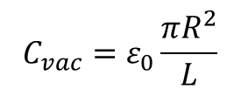
Building a simple plasma reactor, which in its simplest form is basically a high voltage gas filled capacitor
Will try to keep this as simple as possible, but unfortunately at some point things have to get a little ugly, but not super ugly…
R
p, n_{g}, T_{g}
L
$$C_{vac}=ε_{0}\frac{πR^{2}}{L}$$

Slide 26


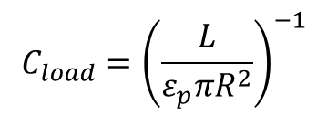


What happens if we fill this capacitor with a plasma?
Note: most processing “plasmas” are still composed of around 99.9% neutral gas species
$$n_{g}=\frac{p}{kT_{g}}≈3×{10}^{15}{cm}^{−3}@100mTorr 300K$$
$n_{e}=n_{i}≈{10}^{8}{cm}^{−3}−{10}^{12}{cm}^{−3}$ typically
$$T_{e}≈2eV−10eV typically$$
$T_{i}≈0.03eV−0.1eV$ typically
R
n_{i}, T_{i}, n_{e}, T_{e}, p, n_{g}, T_{g}
L
$$C_{vac}=ε_{0}\frac{πR^{2}}{L}$$
$$C_{load}={\left(\frac{L}{ε_{p}πR^{2}}\right)}^{−1}$$

Slide 27
What happens if we fill this capacitor with a plasma?
Note: most processing “plasmas” are still composed of around 99.9% neutral gas species
$$n_{g}=\frac{p}{kT_{g}}≈3×{10}^{15}{cm}^{−3}@100mTorr 300K$$
$n_{e}=n_{i}≈{10}^{8}{cm}^{−3}−{10}^{12}{cm}^{−3}$ typically
$$T_{e}≈2eV−10eV typically$$
$T_{i}≈0.03eV−0.1eV$ typically
At time t = 0, the entire cylinder is filled with an equal distribution of electrons and ions
R
n_{i}, T_{i}, n_{e}, T_{e}, p, n_{g}, T_{g}
L
$$C_{vac}=ε_{0}\frac{πR^{2}}{L}$$
$$C_{load}={\left(\frac{L}{ε_{p}πR^{2}}\right)}^{−1}$$

Slide 28
What happens if we fill this capacitor with a plasma?
Note: most processing “plasmas” are still composed of around 99.9% neutral gas species
-+-+-+-+-+-+-+-+-
$$n_{g}=\frac{p}{kT_{g}}≈3×{10}^{15}{cm}^{−3}@100mTorr 300K$$
e⁻
i⁺
e⁻
i⁺
$n_{e}=n_{i}≈{10}^{8}{cm}^{−3}−{10}^{12}{cm}^{−3}$ typically
$$T_{e}≈2eV−10eV typically$$
$T_{i}≈0.03eV−0.1eV$ typically
R
At time 0 < t < λ_{de}/v_{e}, charged species move to the wall, where they are lost to the system as the charge goes to ground or accumulates on surface
n_{i}, T_{i}, n_{e}, T_{e}, p, n_{g}, T_{g}
L
$$C_{vac}=ε_{0}\frac{πR^{2}}{L}$$
$$C_{load}={\left(\frac{L}{ε_{p}πR^{2}}\right)}^{−1}$$

Slide 29
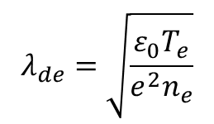
What happens if we fill this capacitor with a plasma?
Note: most processing “plasmas” are still composed of around 99.9% neutral gas species
-+-+-+-+-+-+-+-+-
$$n_{g}=\frac{p}{kT_{g}}≈3×{10}^{15}{cm}^{−3}@100mTorr 300K$$
e⁻
i⁺
e⁻
i⁺
$n_{e}=n_{i}≈{10}^{8}{cm}^{−3}−{10}^{12}{cm}^{−3}$ typically
$$T_{e}≈2eV−10eV typically$$
$T_{i}≈0.03eV−0.1eV$ typically
R
λ_{de} is the Debye Length of the plasma – the distance needed for a plasma to locally screen out a point charge, and is a typical “scale length” for a plasma
n_{i}, T_{i}, n_{e}, T_{e}, p, n_{g}, T_{g}
L
$$λ_{de}=\sqrt{\frac{ε_{0}T_{e}}{e^{2}n_{e}}}$$
$$C_{vac}=ε_{0}\frac{πR^{2}}{L}$$
$$C_{load}={\left(\frac{L}{ε_{p}πR^{2}}\right)}^{−1}$$

Slide 30
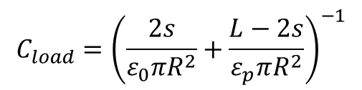
What happens if we fill this capacitor with a plasma?
Note: most processing “plasmas” are still composed of around 99.9% neutral gas species
---+---+---+---+---
$$n_{g}=\frac{p}{kT_{g}}≈3×{10}^{15}{cm}^{−3}@100mTorr 300K$$
s
e⁻
i⁺
e⁻
i⁺
$n_{e}=n_{i}≈{10}^{8}{cm}^{−3}−{10}^{12}{cm}^{−3}$ typically
s
$$T_{e}≈2eV−10eV typically$$
$T_{i}≈0.03eV−0.1eV$ typically
R
At time λ_{de}/v_{e} < t < λ_{de}/v_{i}, Since electrons are thousands of times lighter than ions, they are more mobile and an electron depletion region forms around the surfaces
n_{i}, T_{i}, n_{e}, T_{e}, p, n_{g}, T_{g}
L
d = L – 2s
$$C_{vac}=ε_{0}\frac{πR^{2}}{L}$$
$$C_{load}={\left(\frac{2s}{ε_{0}πR^{2}}+\frac{L−2s}{ε_{p}πR^{2}}\right)}^{−1}$$

Slide 31
What happens if we fill this capacitor with a plasma?
Note: most processing “plasmas” are still composed of around 99.9% neutral gas species
---+---+---+---+---
$$n_{g}=\frac{p}{kT_{g}}≈3×{10}^{15}{cm}^{−3}@100mTorr 300K$$
s
E
e⁻
i⁺
e⁻
i⁺
$n_{e}=n_{i}≈{10}^{8}{cm}^{−3}−{10}^{12}{cm}^{−3}$ typically
s
E
$$T_{e}≈2eV−10eV typically$$
$T_{i}≈0.03eV−0.1eV$ typically
R
At time t > λ_{de}/v_{i} the electron depletion creates an electric field to zero diffusion current similar to the depletion region of a PN junction
n_{i}, T_{i}, n_{e}, T_{e}, p, n_{g}, T_{g}
L
d = L – 2s
$$C_{vac}=ε_{0}\frac{πR^{2}}{L}$$
$$C_{load}={\left(\frac{2s}{ε_{0}πR^{2}}+\frac{L−2s}{ε_{p}πR^{2}}\right)}^{−1}$$

Slide 32




What happens if we fill this capacitor with a plasma?
Note: most processing “plasmas” are still composed of around 99.9% neutral gas species
---+---+---+---+---
$$n_{g}=\frac{p}{kT_{g}}≈3×{10}^{15}{cm}^{−3}@100mTorr 300K$$
s
E
e⁻
i⁺
e⁻
i⁺
$n_{e}=n_{i}≈{10}^{8}{cm}^{−3}−{10}^{12}{cm}^{−3}$ typically
s
E
$$T_{e}≈2eV−10eV typically$$
$T_{i}≈0.03eV−0.1eV$ typically
R
$$∇∙\vec{E}=∇^{2}V=\frac{ρ}{ε}≈−\frac{en_{e}}{ε}$$
V_{f}
$V_{f}=−T_{e}\ln{\sqrt{\frac{m_{ion}}{2πm_{e}}}}\sim −20V$ in 5eV Ar
n_{i}, T_{i}, n_{e}, T_{e}, V_{p}, p, n_{g}, T_{g}
L
d = L – 2s
$$V_{p}=\frac{m_{ion}}{2e}{u_{B}^{}}^{2}=\frac{m_{ion}}{2e}\frac{eT_{e}}{m_{ion}}=\frac{T_{e}}{2}$$
$s\sim 0.5mm$ 5eV Ar 10¹⁰cm⁻³
$$C_{vac}=ε_{0}\frac{πR^{2}}{L}$$
$$C_{load}={\left(\frac{2s}{ε_{0}πR^{2}}+\frac{L−2s}{ε_{p}πR^{2}}\right)}^{−1}$$

Slide 33




What happens if we fill this capacitor with a plasma?
Note: most processing “plasmas” are still composed of around 99.9% neutral gas species
---+---+---+---+---
$$n_{g}=\frac{p}{kT_{g}}≈3×{10}^{15}{cm}^{−3}@100mTorr 300K$$
s
E
e⁻
i⁺
e⁻
i⁺
$n_{e}=n_{i}≈{10}^{8}{cm}^{−3}−{10}^{12}{cm}^{−3}$ typically
s
E
$$T_{e}≈2eV−10eV typically$$
$T_{i}≈0.03eV−0.1eV$ typically
R
The electric field accelerates ions normal to the surface, providing ion flux to ONLY horizontal surfaces and accelerating reactions on those surfaces
V_{f}
n_{i}, T_{i}, n_{e}, T_{e}, V_{p}, p, n_{g}, T_{g}
L
d = L – 2s
ACHIEVED!
$$C_{vac}=ε_{0}\frac{πR^{2}}{L}$$
$$C_{load}={\left(\frac{2s}{ε_{0}πR^{2}}+\frac{L−2s}{ε_{p}πR^{2}}\right)}^{−1}$$

Slide 34
What happens if we fill this capacitor with a plasma?
Note: most processing “plasmas” are still composed of around 99.9% neutral gas species
n
i⁺
n
n
n
$$n_{g}=\frac{p}{kT_{g}}≈3×{10}^{15}{cm}^{−3}@100mTorr 300K$$
e⁻
n
$n_{e}=n_{i}≈{10}^{8}{cm}^{−3}−{10}^{12}{cm}^{−3}$ typically
$$T_{e}≈2eV−10eV typically$$
$T_{i}≈0.03eV−0.1eV$ typically
Meanwhile, in the bulk plasma region, the faster electrons collide mainly with neutral gas species
Elastic collisions (polarization scattering)
Inelastic collisions – excitation, dissociation
Ionization collisions – have a threshold energy, produce more e-i pairs
R
V_{f}
n_{i}, T_{i}, n_{e}, T_{e}, V_{p}, p, n_{g}, T_{g}
L
d = L – 2s
$$C_{vac}=ε_{0}\frac{πR^{2}}{L}$$
$$C_{load}={\left(\frac{2s}{ε_{0}πR^{2}}+\frac{L−2s}{ε_{p}πR^{2}}\right)}^{−1}$$

Slide 35
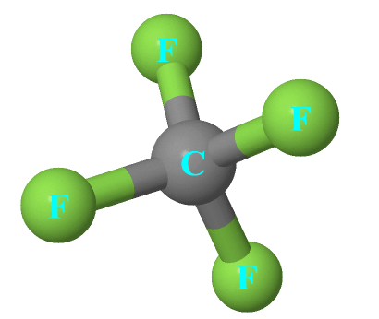
What happens if we fill this capacitor with a plasma?
Note: most processing “plasmas” are still composed of around 99.9% neutral gas species
n
i⁺
E > 5eV
n
n
n
e
$$n_{g}=\frac{p}{kT_{g}}≈3×{10}^{15}{cm}^{−3}@100mTorr 300K$$
e⁻
n
$n_{e}=n_{i}≈{10}^{8}{cm}^{−3}−{10}^{12}{cm}^{−3}$ typically
C-F bond energy
~5eV
$$T_{e}≈2eV−10eV typically$$
$T_{i}≈0.03eV−0.1eV$ typically
Meanwhile, in the bulk plasma region, the faster electrons collide mainly with neutral gas species
Elastic collisions (polarization scattering)
Inelastic collisions – excitation, dissociation
Ionization collisions – have a threshold energy, produce more e-i pairs
R
V_{f}
n_{i}, T_{i}, n_{e}, T_{e}, V_{p}, p, n_{g}, T_{g}
L
d = L – 2s
$$C_{vac}=ε_{0}\frac{πR^{2}}{L}$$
$$C_{load}={\left(\frac{2s}{ε_{0}πR^{2}}+\frac{L−2s}{ε_{p}πR^{2}}\right)}^{−1}$$

Slide 36
What happens if we fill this capacitor with a plasma?
Note: most processing “plasmas” are still composed of around 99.9% neutral gas species
n
i⁺
n
E < 5eV
n
n
$$n_{g}=\frac{p}{kT_{g}}≈3×{10}^{15}{cm}^{−3}@100mTorr 300K$$
e
e⁻
n
$n_{e}=n_{i}≈{10}^{8}{cm}^{−3}−{10}^{12}{cm}^{−3}$ typically
$$T_{e}≈2eV−10eV typically$$
$T_{i}≈0.03eV−0.1eV$ typically
Meanwhile, in the bulk plasma region, the faster electrons collide mainly with neutral gas species
Elastic collisions (polarization scattering)
Inelastic collisions – excitation, dissociation
Ionization collisions – have a threshold energy, produce more e-i pairs
R
V_{f}
n_{i}, T_{i}, n_{e}, T_{e}, V_{p}, p, n_{g}, T_{g}
L
d = L – 2s
$$C_{vac}=ε_{0}\frac{πR^{2}}{L}$$
$$C_{load}={\left(\frac{2s}{ε_{0}πR^{2}}+\frac{L−2s}{ε_{p}πR^{2}}\right)}^{−1}$$

Slide 37
What happens if we fill this capacitor with a plasma?
Note: most processing “plasmas” are still composed of around 99.9% neutral gas species
n
i⁺
n
E < 5eV
n
n
$$n_{g}=\frac{p}{kT_{g}}≈3×{10}^{15}{cm}^{−3}@100mTorr 300K$$
e
e⁻
n
$n_{e}=n_{i}≈{10}^{8}{cm}^{−3}−{10}^{12}{cm}^{−3}$ typically
$$T_{e}≈2eV−10eV typically$$
The rate per unit volume of a specific collision is determined by four factors:
The number of electrons n_{e}
The number of targets for the electron to hit n_{target}
The velocity of the electron (2E_{e}/m_{e})^{1/2}
The effective size of the target atom or molecule for that collision, the cross section σ
$T_{i}≈0.03eV−0.1eV$ typically
R
V_{f}
n_{i}, T_{i}, n_{e}, T_{e}, V_{p}, p, n_{g}, T_{g}
L
d = L – 2s
$$C_{vac}=ε_{0}\frac{πR^{2}}{L}$$
$$C_{load}={\left(\frac{2s}{ε_{0}πR^{2}}+\frac{L−2s}{ε_{p}πR^{2}}\right)}^{−1}$$

Slide 38
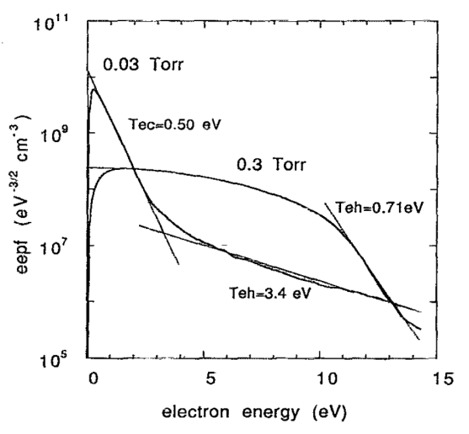
What happens if we fill this capacitor with a plasma?
Note: most processing “plasmas” are still composed of around 99.9% neutral gas species
n
i⁺
n
E < 5eV
n
n
$$n_{g}=\frac{p}{kT_{g}}≈3×{10}^{15}{cm}^{−3}@100mTorr 300K$$
e
e⁻
n
$n_{e}=n_{i}≈{10}^{8}{cm}^{−3}−{10}^{12}{cm}^{−3}$ typically
$$T_{e}≈2eV−10eV typically$$
The velocity of the electron – be careful here, electrons in a plasma have a distribution of energies, not always Maxwellian
$T_{i}≈0.03eV−0.1eV$ typically
J. Appl. Phys. 73 (8), 1993 3657-3664
R
30 mTorr
V_{f}
300 mTorr
n_{i}, T_{i}, n_{e}, T_{e}, V_{p}, p, n_{g}, T_{g}
L
d = L – 2s
$$C_{vac}=ε_{0}\frac{πR^{2}}{L}$$
$$C_{load}={\left(\frac{2s}{ε_{0}πR^{2}}+\frac{L−2s}{ε_{p}πR^{2}}\right)}^{−1}$$

Slide 39
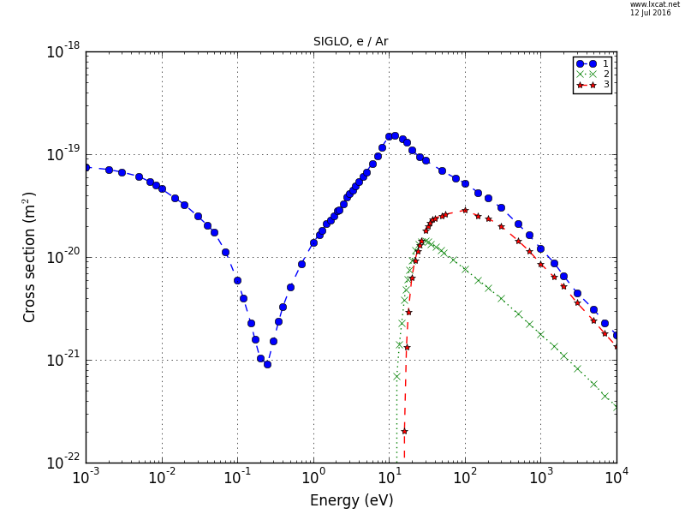
What happens if we fill this capacitor with a plasma?
Note: most processing “plasmas” are still composed of around 99.9% neutral gas species
n
i⁺
n
E < 5eV
n
n
$$n_{g}=\frac{p}{kT_{g}}≈3×{10}^{15}{cm}^{−3}@100mTorr 300K$$
e
e⁻
n
$n_{e}=n_{i}≈{10}^{8}{cm}^{−3}−{10}^{12}{cm}^{−3}$ typically
$$T_{e}≈2eV−10eV typically$$
The target size of the atom or molecule can be a strong function of an individual electron’s energy
$T_{i}≈0.03eV−0.1eV$ typically
R
Elastic
Excitation (composite)
Ionization
E_{iz}, E_{ex}
V_{f}
n_{i}, T_{i}, n_{e}, T_{e}, V_{p}, p,
E_{iz}, E_{ex}, n_{g}, T_{g}
L
d = L – 2s
www.lxcat.net/SIGLO
$$C_{vac}=ε_{0}\frac{πR^{2}}{L}$$
$$C_{load}={\left(\frac{2s}{ε_{0}πR^{2}}+\frac{L−2s}{ε_{p}πR^{2}}\right)}^{−1}$$

Slide 40
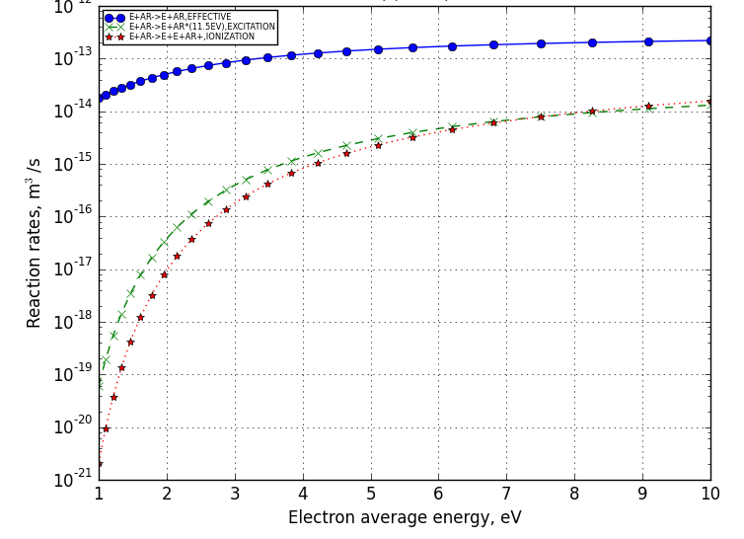
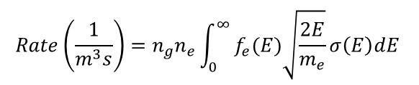
What happens if we fill this capacitor with a plasma?
Note: most processing “plasmas” are still composed of around 99.9% neutral gas species
n
i⁺
n
E < 5eV
n
n
$$n_{g}=\frac{p}{kT_{g}}≈3×{10}^{15}{cm}^{−3}@100mTorr 300K$$
e
e⁻
n
K
$n_{e}=n_{i}≈{10}^{8}{cm}^{−3}−{10}^{12}{cm}^{−3}$ typically
$$Rate\left(\frac{1}{m^{3}s}\right)=n_{g}n_{e}\int_{0}^{∞}{f_{e}(E)\sqrt{\frac{2E}{m_{e}}}σ\left(E\right)dE }$$
$$T_{e}≈2eV−10eV typically$$
$T_{i}≈0.03eV−0.1eV$ typically
R
V_{f}
Assume a form of f_{e}(E)
n_{i}, T_{i}, n_{e}, T_{e}, V_{p}, p, K_{me},
K_{ex}, K_{iz}, E_{iz}, E_{ex}, n_{g}, T_{g}
L
d = L – 2s
www.lxcat.net/SIGLO
BOLSIG solver, Maxwellian Assumption
$$C_{vac}=ε_{0}\frac{πR^{2}}{L}$$
$$C_{load}={\left(\frac{2s}{ε_{0}πR^{2}}+\frac{L−2s}{ε_{p}πR^{2}}\right)}^{−1}$$

Slide 41
What happens if we fill this capacitor with a plasma?
This gives us reaction rates (K), just like in chemistry, but they are a function of the electron’s temperature, NOT the gas temperature
But – we do get reactive gas species without heating up the background gas much
Note: most processing “plasmas” are still composed of around 99.9% neutral gas species
n
i⁺
n
n
n
$$n_{g}=\frac{p}{kT_{g}}≈3×{10}^{15}{cm}^{−3}@100mTorr 300K$$
K
e⁻
n
$n_{e}=n_{i}≈{10}^{8}{cm}^{−3}−{10}^{12}{cm}^{−3}$ typically
$$Rate\left(\frac{1}{m^{3}s}\right)=n_{g}n_{e}\int_{0}^{∞}{f_{e}(E)\sqrt{\frac{2E}{m_{e}}}σ\left(E\right)dE }$$
$$T_{e}≈2eV−10eV typically$$
$T_{i}≈0.03eV−0.1eV$ typically
R
V_{f}
Assume a form of f_{e}(E)
n_{i}, T_{i}, n_{e}, T_{e}, V_{p}, p, K_{me},
K_{ex}, K_{iz}, E_{iz}, E_{ex}, n_{g}, T_{g}
L
d = L – 2s
www.lxcat.net/SIGLO
BOLSIG solver, Maxwellian Assumption
$$C_{vac}=ε_{0}\frac{πR^{2}}{L}$$
$$C_{load}={\left(\frac{2s}{ε_{0}πR^{2}}+\frac{L−2s}{ε_{p}πR^{2}}\right)}^{−1}$$

Slide 42
What happens if we fill this capacitor with a plasma?
Note: most processing “plasmas” are still composed of around 99.9% neutral gas species
This gives us reaction rates (K), just like in chemistry, but they are a function of the electron’s temperature, NOT the gas temperature
But – we do get reactive gas species without heating up the background gas much and we can control it with electron temperature
n
i⁺
n
n
n
$$n_{g}=\frac{p}{kT_{g}}≈3×{10}^{15}{cm}^{−3}@100mTorr 300K$$
K
e⁻
n
$n_{e}=n_{i}≈{10}^{8}{cm}^{−3}−{10}^{12}{cm}^{−3}$ typically
$$Rate\left(\frac{1}{m^{3}s}\right)=n_{g}n_{e}\int_{0}^{∞}{f_{e}(E)\sqrt{\frac{2E}{m_{e}}}σ\left(E\right)dE }$$
$$T_{e}≈2eV−10eV typically$$
$T_{i}≈0.03eV−0.1eV$ typically
R
V_{f}
ACHIEVED!
n_{i}, T_{i}, n_{e}, T_{e}, V_{p}, p, K_{me},
K_{ex}, K_{iz}, E_{iz}, E_{ex}, n_{g}, T_{g}
L
d = L – 2s
Assume a form of f_{e}(E)
www.lxcat.net/SIGLO
BOLSIG solver, Maxwellian Assumption
$$C_{vac}=ε_{0}\frac{πR^{2}}{L}$$
$$C_{load}={\left(\frac{2s}{ε_{0}πR^{2}}+\frac{L−2s}{ε_{p}πR^{2}}\right)}^{−1}$$

Slide 43
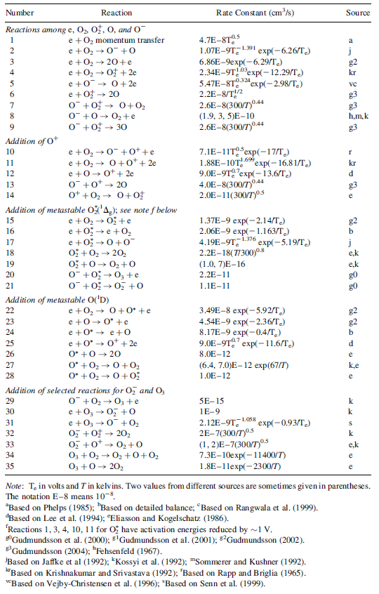
However - the list of reactions gets very long, and very difficult to set up and solve balance equations
Imagine the list of pertinent reactions for something like SF₆, CF₄, C₄F₈, or Si(OC₂H₅)₄ (TEOS)
Even worse, realize that rarely is only one gas used for a process. Dielectric etch would run Ar, O₂, and C₄F₈ at the same time.
And even if you could build a complete set of reactions, the cross sections and rate constants for many of these species are at best “qualitative”

Slide 44
And the list of reactions gets very long, and very difficult to set up and solve balance equations
624 Reactions!

Slide 45
And the list of reactions gets very long, and very difficult to set up and solve balance equations
Electron Impact Driven
624 Reactions!
Excited Atomic and
Molecular Specie Driven
Boltzmann
Reactions
Positive (and negative)
Ion Driven Reactions
Reactions where we have to “guess”
Charge Exchange Free Electron Forming
“Boring” Gas Phase Ground State Stuff

Slide 46
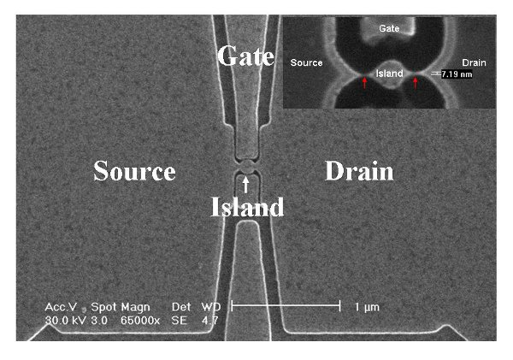
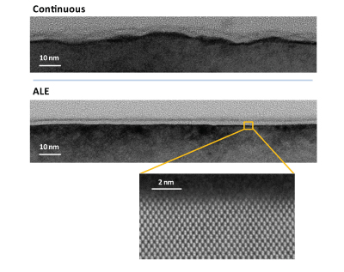
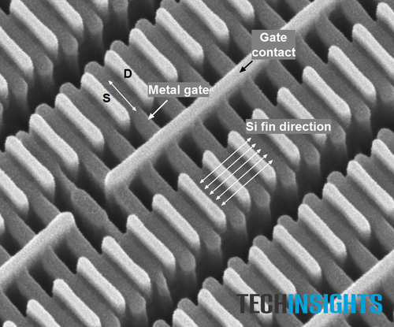
Plasma technology has had (and still does) need to keep pace
1990’s – etch rate, etch selectivity, dual damescene
2000’s – profile shape, aspect ratio, 300mm
2010’s – aspect ratio, complex material stacks, residual material damage
2020’s – (one person’s opinion at least) – new pathways for anisotropy + advanced chemistry control to maintain anisotropy with minimal device damage down to the atomic scale
Silicon Quantum Dot
Single electron transistor
Michael Wang, Lithography,
Intech Press (2010)
Keren Kanarik et. al., “Moving atomic layer etch
from lab to fab”, Solid State Technology Magazine,
January 2014
Kevin Gibb, “Samsung’s 14 nm LPE
FinFET Transistors”, EETimes, 2016

Slide 47
Summary – we need two things to drive device fabrication – ions and reactive low temperature chemistry. Plasmas give us both.
CF₄
Electron driven “breaking” of molecules… don’t use thermal energy, use electron bombardment. This keeps the gas cool
Ion acceleration normal to the surface using naturally occurring electric fields at the plasma edge
Ion acceleration
Through RF sheath
Silicon Wafer

Slide 48
Summary – using plasma technology allows us to combine Thing 1 + Thing 2 to produce the nano-scale devices in electronic equipment today
Electron driven “breaking” of molecules… don’t use thermal energy, use electron bombardment. This keeps the gas cool
Ion acceleration normal to the surface using naturally occurring electric fields at the plasma edge

Slide 49







Acknowledgements
Countless students, engineers, scientists, and collaborators over the last 25+ years

